Slide 1
Fuel Chemistry
NE 591

Slide 2
Last Time
Basic materials science overview
Crystal structures
Point defects, dislocations, grain boundaries, etc.
Began fuel chemistry
UO2 stoichiometry

Slide 3
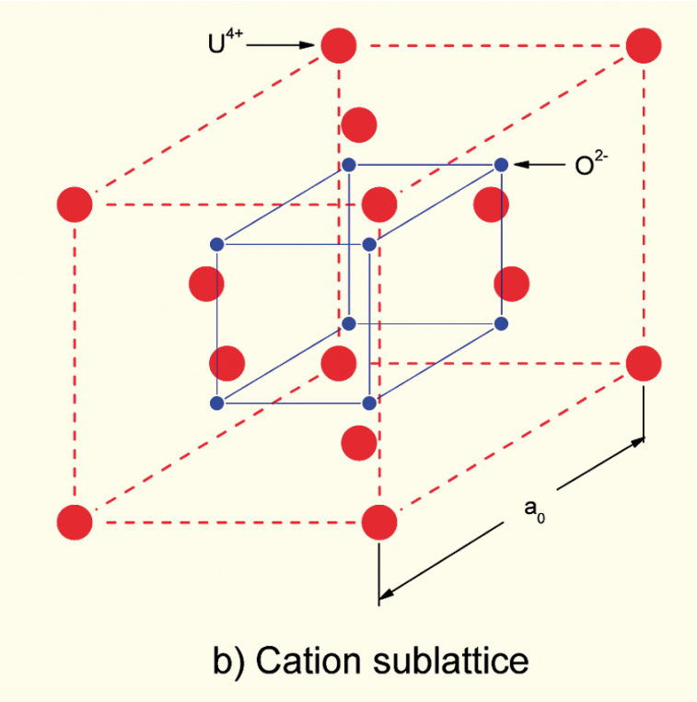
Incorporation of Fission Products
As fission products form, the valence state of the uranium can change
Typical valence of soluble fission products is M³⁺
The uranium valence state changes to compensate
Oxygen liberated by fission
Fission products produced with M³⁺ valance state incorporated in fuel lattice
Uranium oxidizes from U⁴⁺ to U⁵⁺ or U⁶⁺ to maintain local electrical neutrality

Slide 4
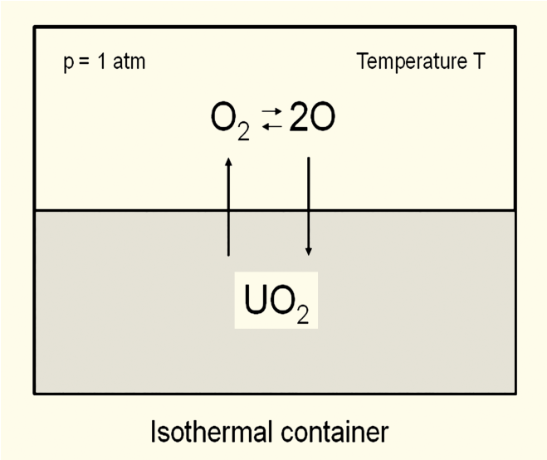
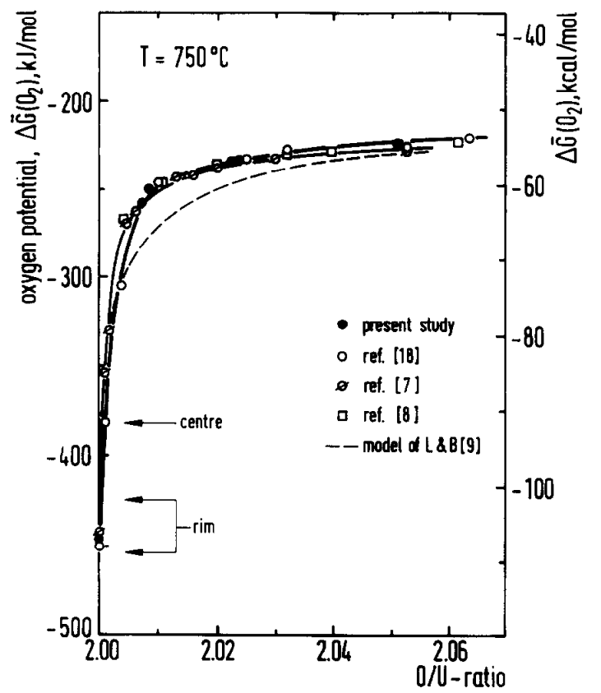
Oxygen potential
The oxygen potential is a measure of how free the oxygen is to escape/move around
Oxygen potential is defined as or, equivalently
With = Chemical potential of oxygen in solution
= Gibbs free energy of gaseous oxygen at temperature T and a standard pressure (1 atm)
It is possible to determine the stoichiometry from the oxygen potential

Slide 5
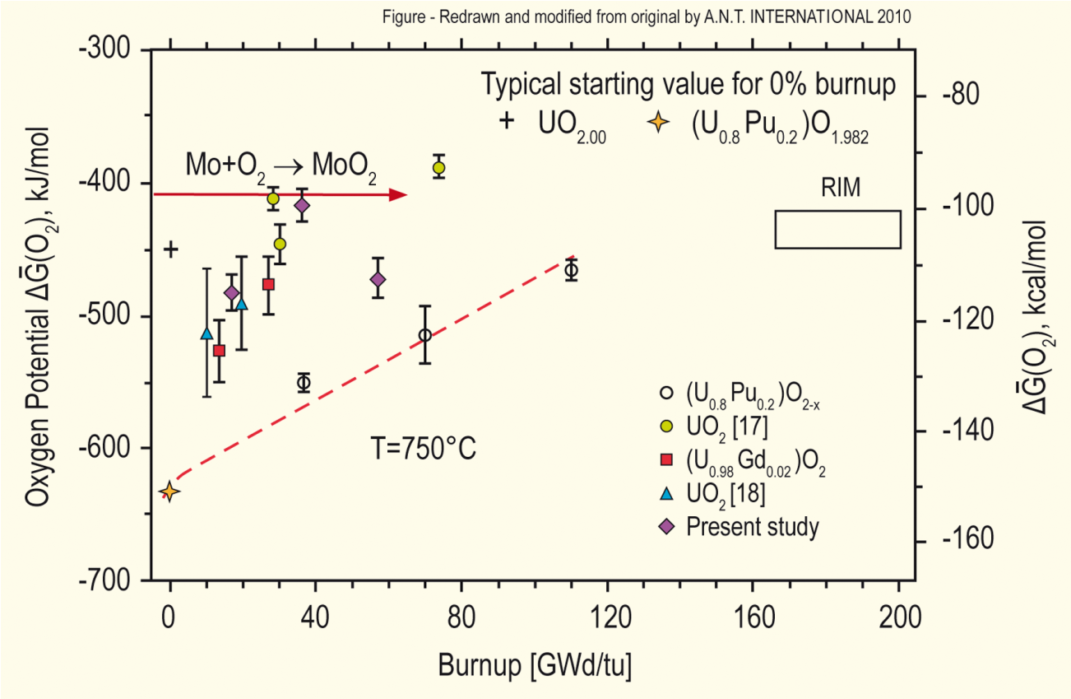
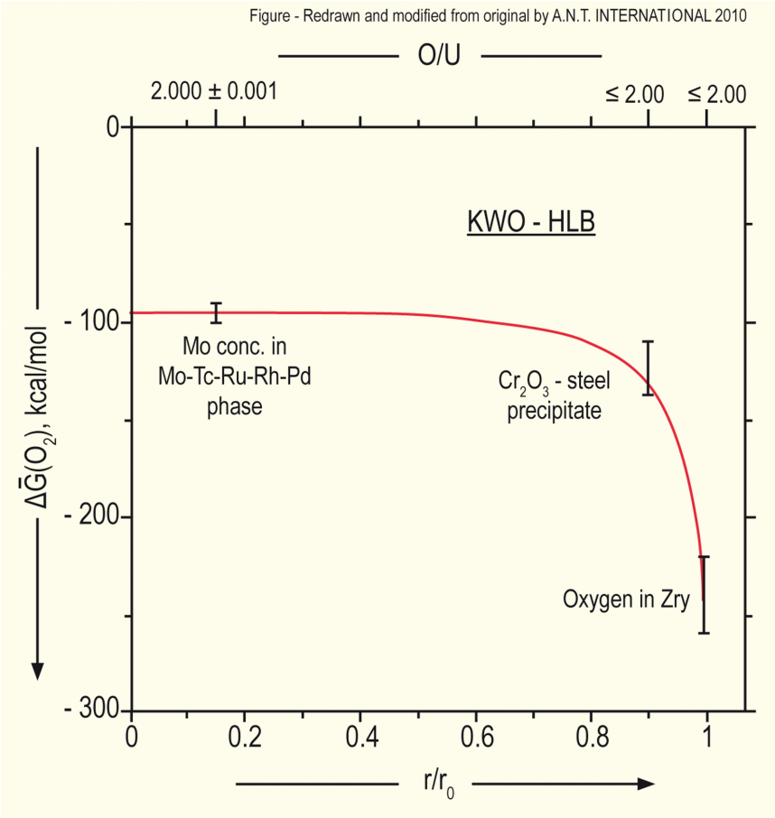
Oxygen potential
The oxygen potential changes during irradiation, indicating change in the O/M ratio
Oxygen potential changes during irradiation due to
Liberation of oxygen by fission
Generation of fission products
Conversion of uranium to plutonium
Reaction of oxygen with U, Pu, fission products, and cladding
Oxygen potential across pellet radius observed to be constant at the approximate value of Mo/MoO₂ reaction (from calculations)
Oxygen potential is low near the cladding, because the oxygen enters the cladding

Slide 6
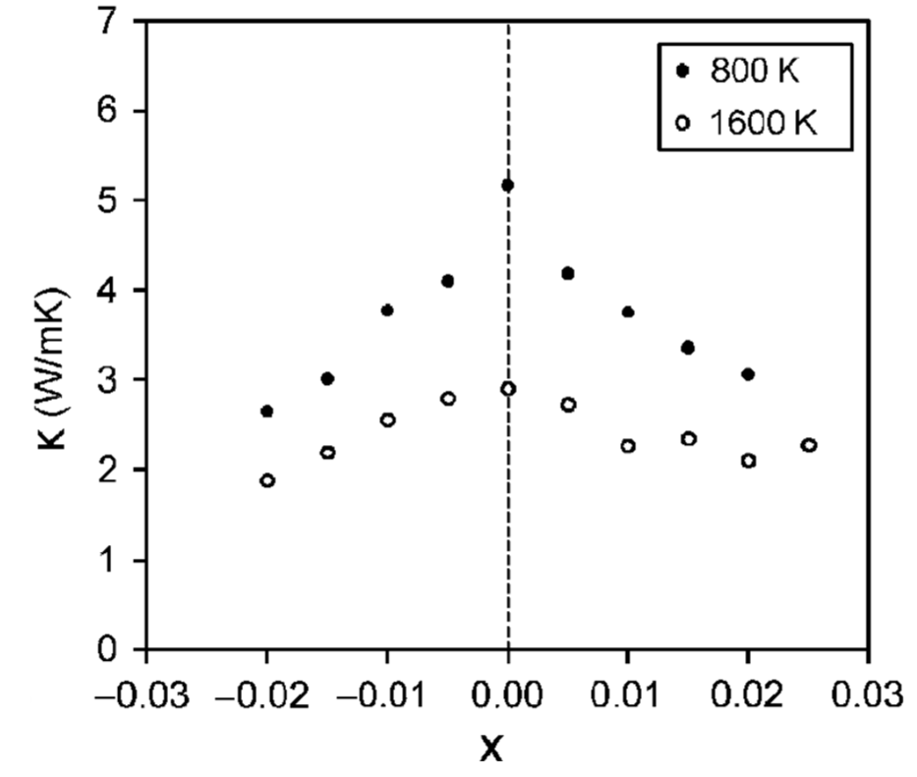
Fuel Stoichiometry/Properties
The stoichiometry of the fuel directly impacts the fuel performance
Stoichiometry impacts
Melting temperature
Thermal conductivity
Processes dependent on diffusion
Grain growth
Fission gas release
Creep
Chemical state and behavior of fission products
Chemical reactions at inner cladding surface
Thermal conductivity is highest for stoichiometric UO2

Slide 7
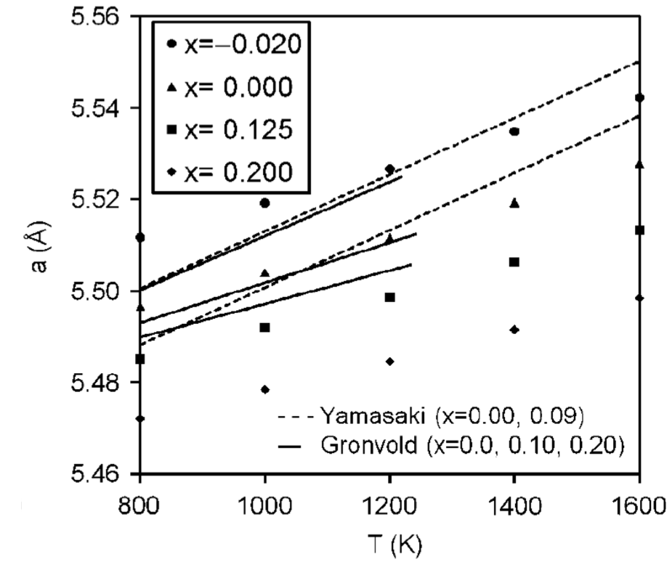
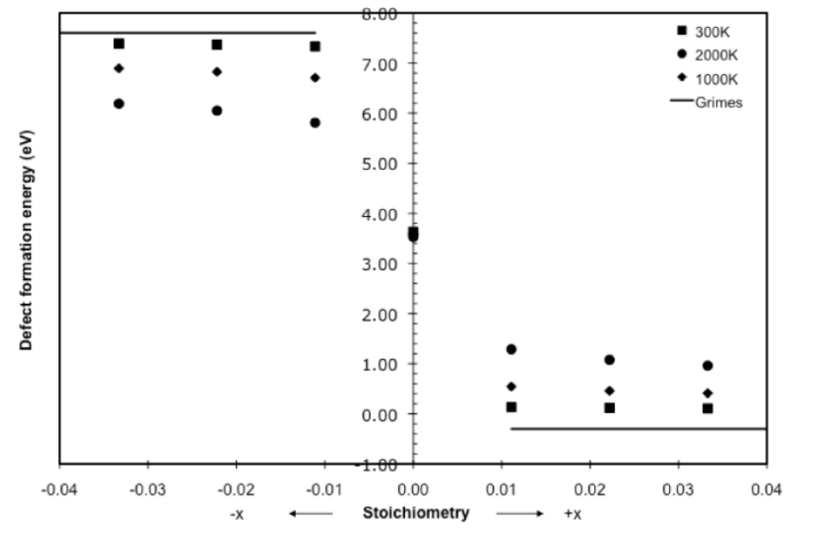
Fuel Stoichiometry/Properties
The lattice constant of the material decreases with increasing stoichiometry
The vacancy formation energy also changes with stoichiometry

Slide 8
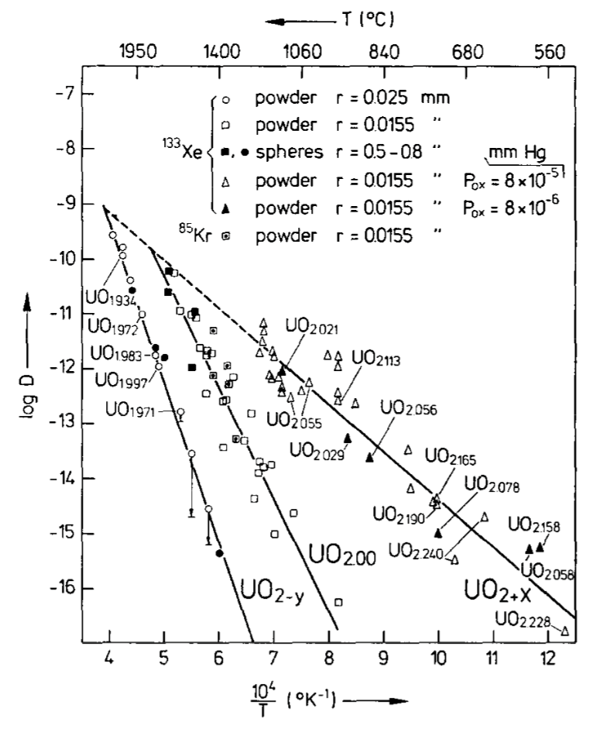
Fuel Stoichiometry/Properties
Fission product | UO_{1.97} | UO₂ | UO_{2.03}
Xe | 3.88 eV | 3.88 ev | 2.61 eV
Cs | 1.7 eV | -0.04 eV | -3.29 eV
Sr | -3.71 eV | -6.03 eV | -9.55 eV
The solution energy of Xe, Cs, and Sr in UO₂ depends on stoichiometry as well
The coefficient defining Xe diffusion also changes with stoichiometry
Though stoichiometry matters, most fuel performance codes ignore it

Slide 9
Fuel Chemistry Summary
UO₂ has a cubic fluorite structure that is very stable
The charges are balanced with a U⁴⁺ valence state
However, the ratio of oxygen to uranium can change. We call this the stoichiometry and abbreviate it as O/M ratio
The O/M ratio changes during reactor operation, but it is complicated
The O/M ratio impacts many properties of the fuel

Slide 10
Grain Growth

Slide 11
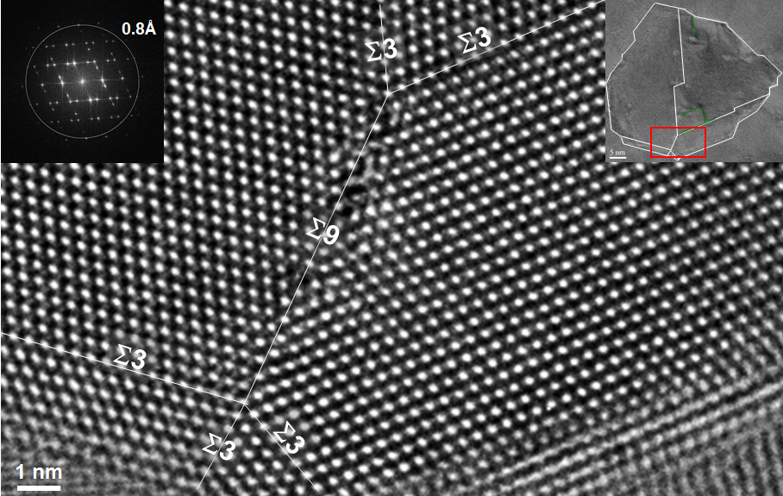
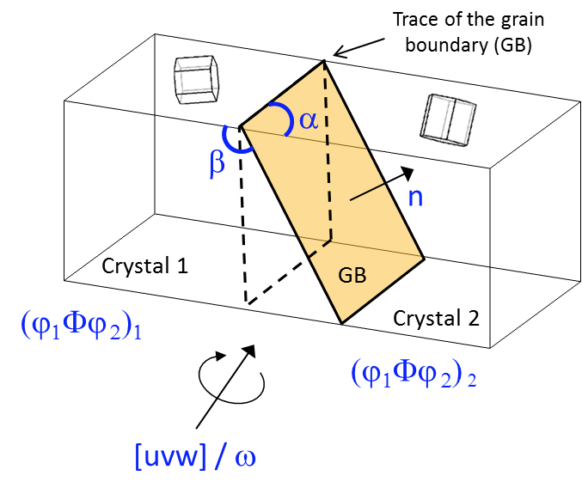
Grain Growth in UO2
Materials are typically composed of various regions where the crystal lattice is oriented differently
When two grains meet, there is a plane of atoms that do not follow the crystal lattice called a grain boundary
Grain boundaries add energy to the material that is a function of their structure
A grain boundary’s energy is determined by its:
Inclination – the orientation of the 2D grain boundary plane (2 degrees of freedom)
misorientation – the rotation required to align one grain with the other (3 degrees of freedom)

Slide 12
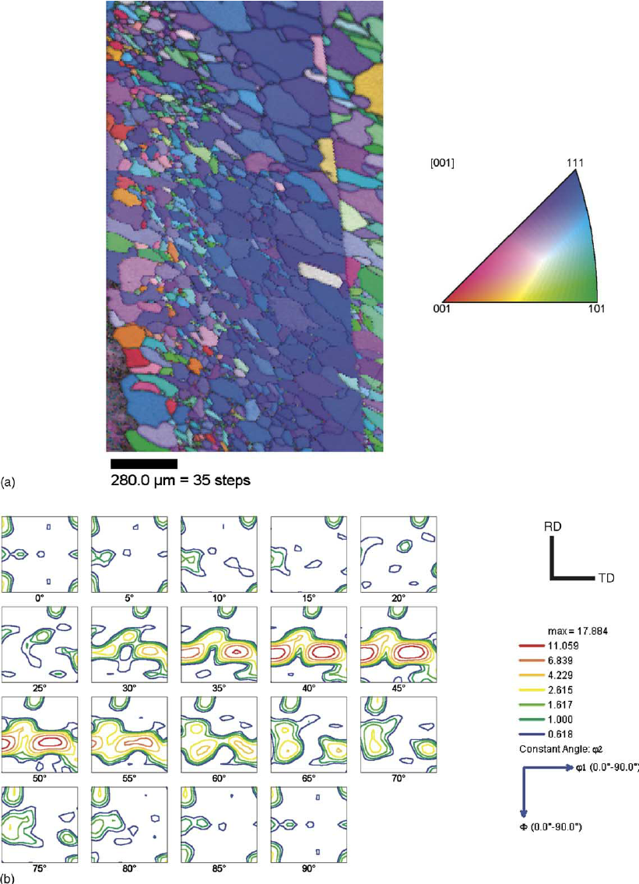
Texture
The orientation of all the grains in a material is called the texture
Orientation distribution function
Electron back scatter diffraction map for cubic crystal structure

Slide 13
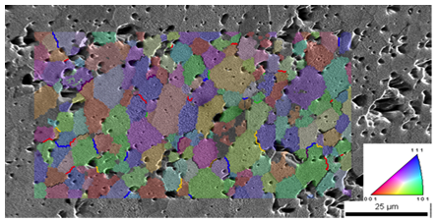
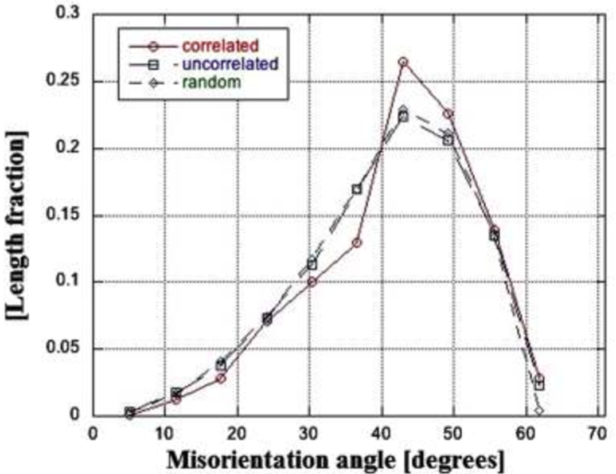
Grain size
In a polycrystal, there is also a distribution of grain sizes
The average grain size of the fuel has a significant impact on its behavior
Typical LWR fuel as an initial average grain size of about 10 microns
The average grain size impacts
Fission gas release
Swelling
Thermal conductivity
Creep

Slide 14
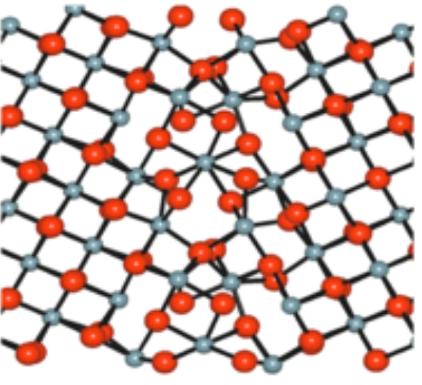
Grain boundary diffusion
Diffusion often occurs faster along grain boundaries than in the perfect crystal
Grain boundaries have more space than the perfect lattice
So, atoms diffuse faster along grain boundaries than through the perfect lattice
This means that grain boundary, or intergranular, diffusion increasingly dominates bulk (intragranular) diffusion as the temperature is reduced
Grain boundary vacancy diffusion has a large impact on creep

Slide 15
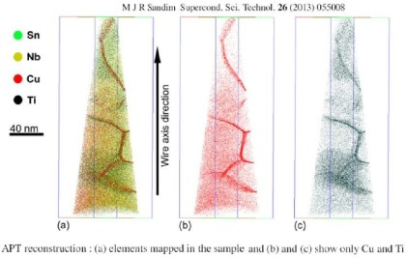
Grain boundary segregation
Impurity atoms (such as fission gas) and other defects move to grain boundaries
Due to grain boundaries having more open space, impurity atoms have a lower energy when they are on grain boundaries.
This is called grain boundary segregation

Slide 16
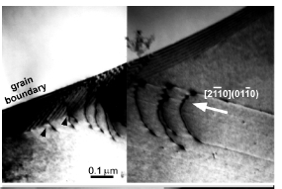
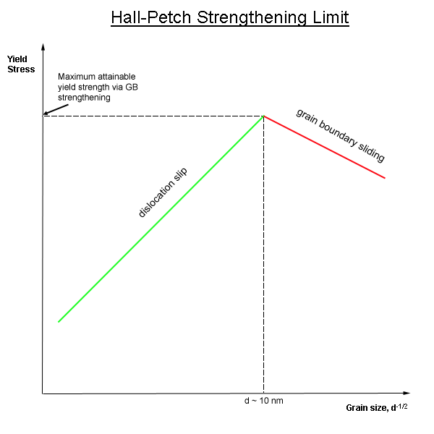
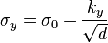
Dislocation interaction with grain boundaries
Grain boundaries impede dislocation motion
The number of dislocations within a grain impacts how easily dislocations can traverse grain boundaries and travel from grain to grain.
So, by changing grain size one can influence dislocation movement and yield strength.
This is called the Hall-Petch effect

Slide 17
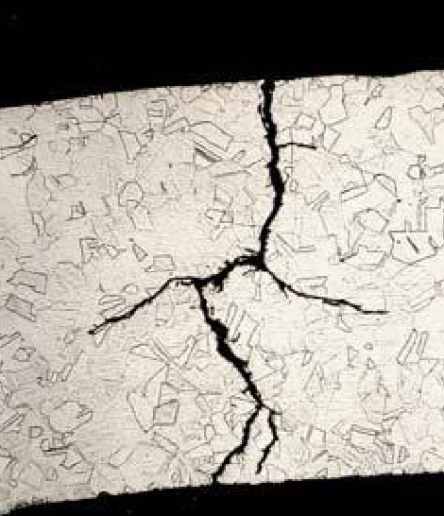
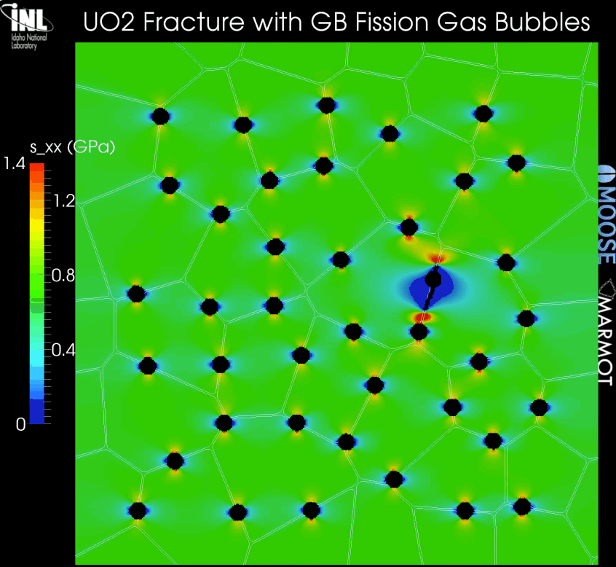
Grain boundaries and cracks
Materials often crack along grain boundaries
Grain boundaries can be weaker than the perfect lattice
Thus, fracture will often occur along grain boundaries (intergranular fracture)

Slide 18
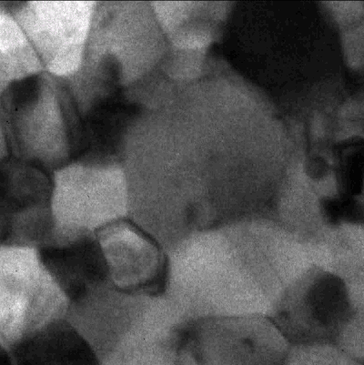
Grain size change
A single crystal has a lower energy state than a polycrystal, due to the grain boundary energy
So, grain boundaries migrate to reduce the energy
v_{GB} = M_{GB} (P_{d} – P_{r})
M_{GB} is the grain boundary mobility
P_{d} is the driving force (pressure) for grain growth
P_{r} is the pressure resisting grain growth

Slide 19
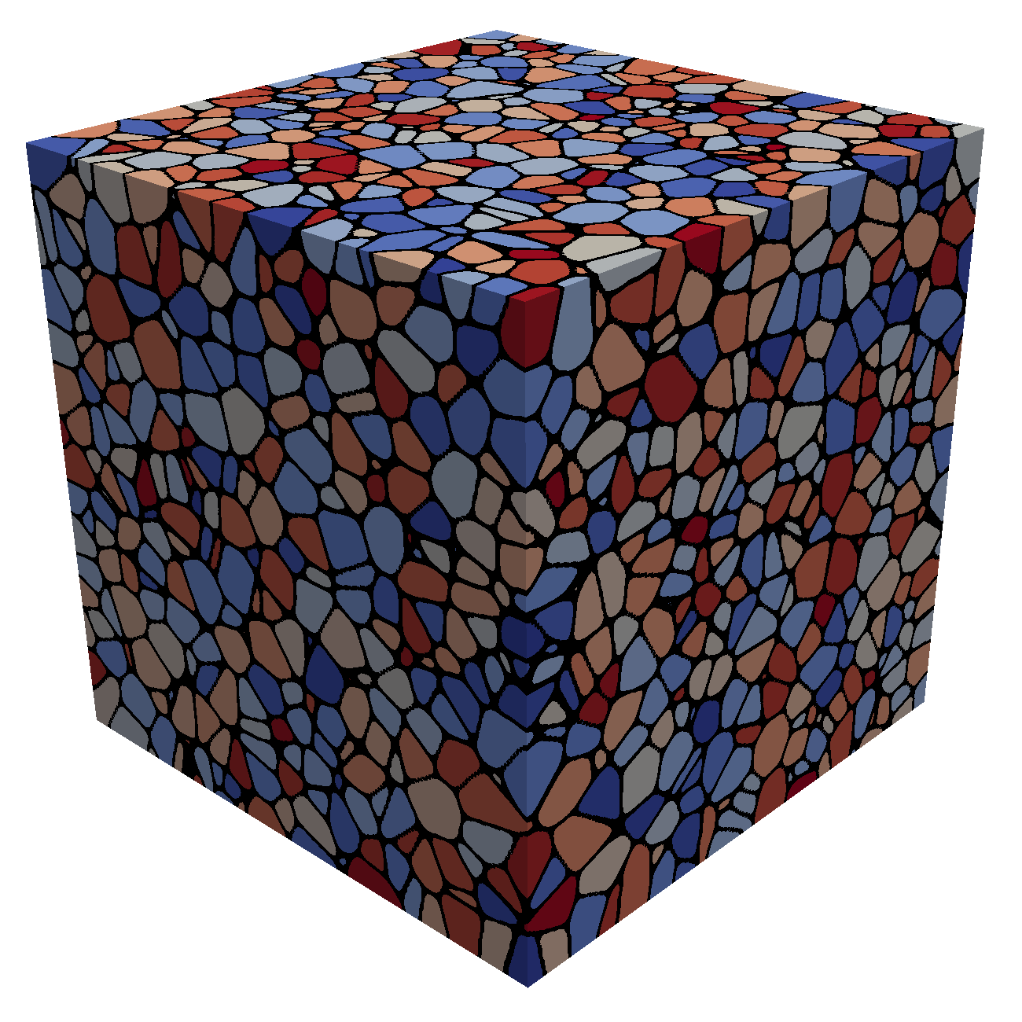
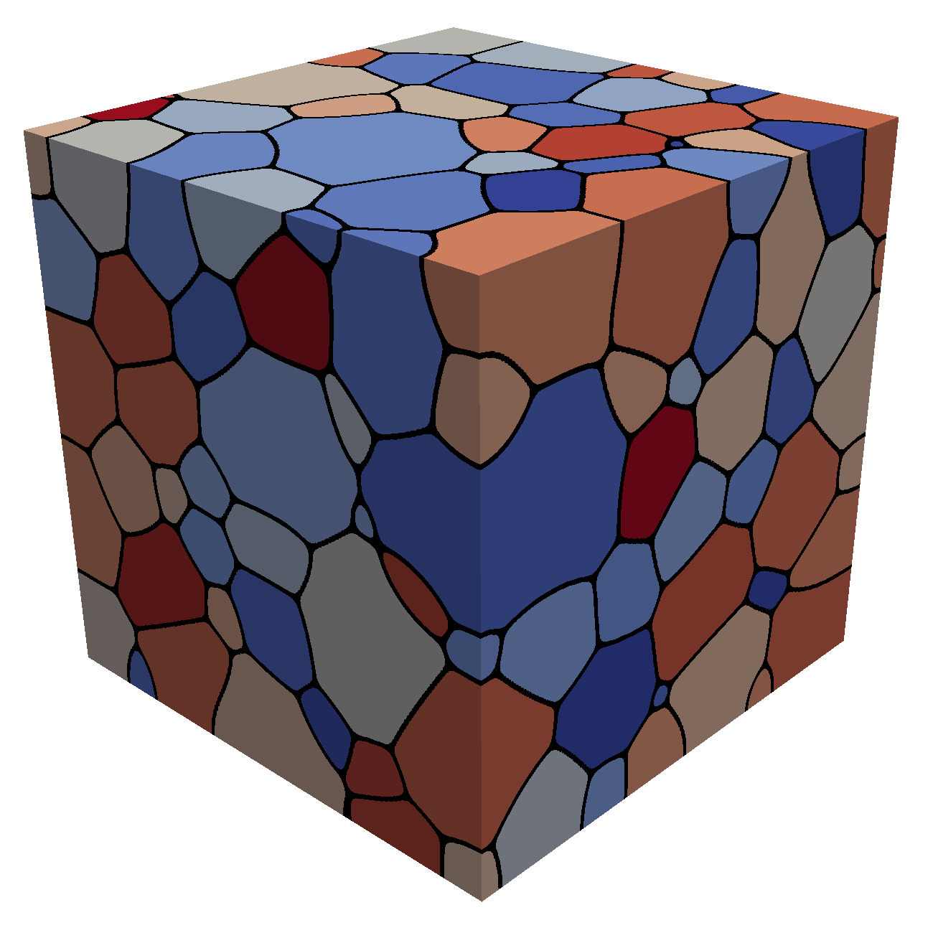
Grain growth
Due to grain boundary migration, the average grain size goes up with time
As grain boundaries migrate, some grains grow and some shrink
Shrinking grains eventually disappear
The average grain volume
Therefore, as N_{grains} decreases due to grain disappearance, the average grain volume goes up

Slide 20
Grain boundary mobility
The grain boundary mobility is a function of temperature and GrB type
The grain boundary mobility is determined according to
m⁴/(J s)
k_{b} = 8.6173e-5 eV/K is the Boltzmann constant
Both the pre-factor M₀ and the activation energy Q change as a function of the grain boundary misorientation
We often use an average grain boundary for a material, taken from polycrystal measurements-> UO2: M₀ (m⁴ /J-s) = 4.6e-09, Q (eV) = 2.77
What is the mobility of UO₂ at 1600 K?
M_{GB} = 4.6e-9*exp(-2.77/(1600*8.6173303e-5)= 8.7e-18 m⁴/J-s

Slide 21
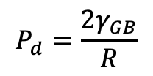
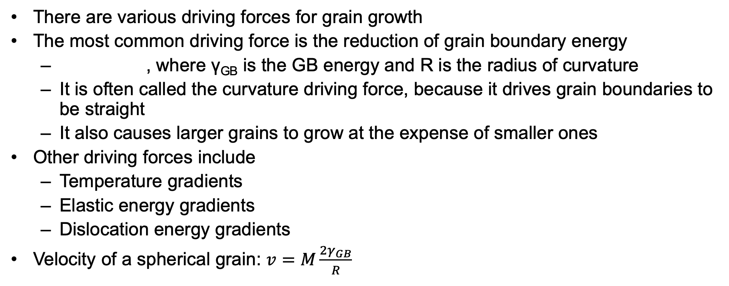
Grain growth
There are various driving forces for grain growth
The most common driving force is the reduction of grain boundary energy
, where γ_{GB} is the GB energy and R is the radius of curvature
It is often called the curvature driving force, because it drives grain boundaries to be straight
It also causes larger grains to grow at the expense of smaller ones
Other driving forces include
Temperature gradients
Elastic energy gradients
Dislocation energy gradients
Velocity of a spherical grain: $v=M\frac{{2γ}_{GB}}{R}$
$$P_{d}=\frac{{2γ}_{GB}}{R}$$

Slide 22
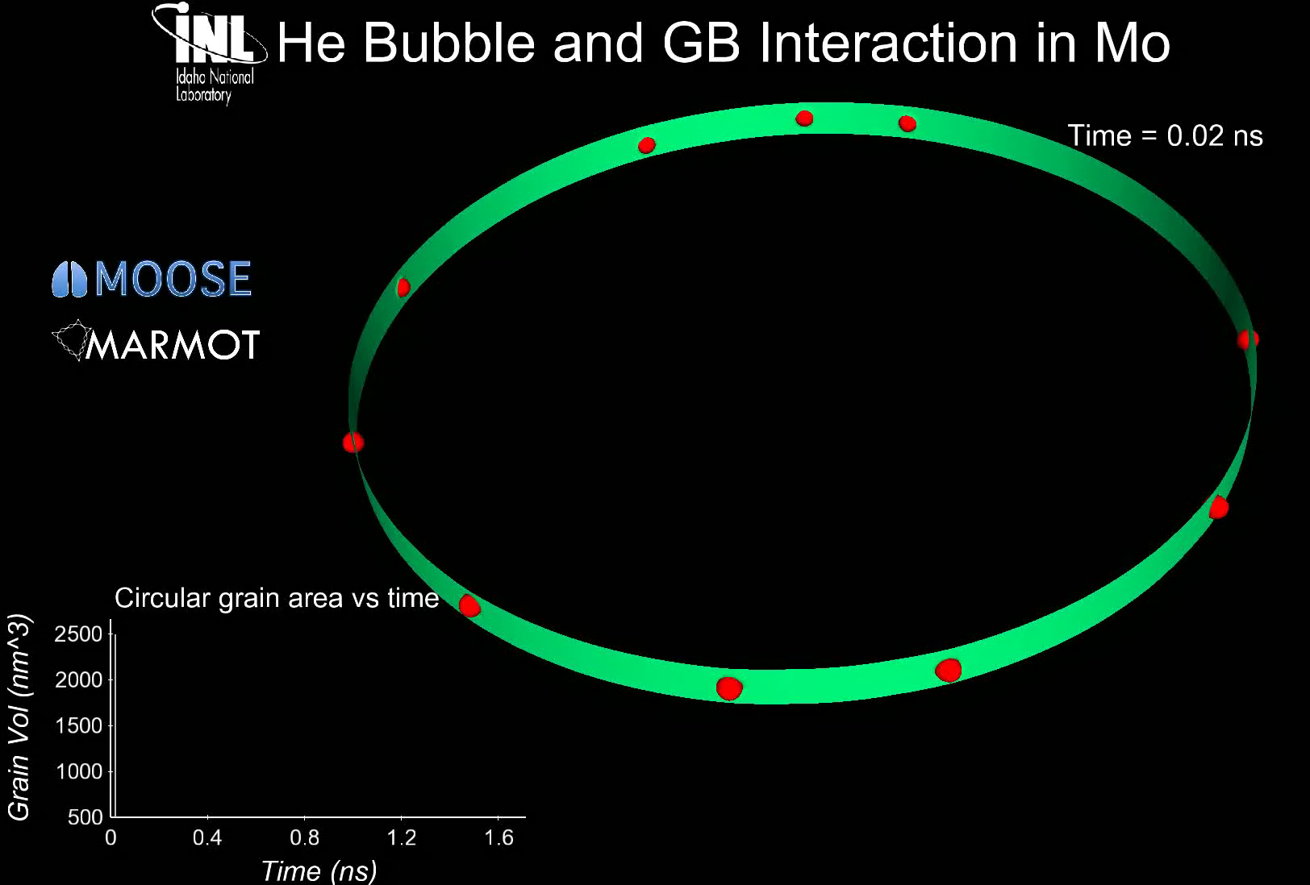
Grain growth
Grain boundary motion is inhibited by pores, precipitates, solute atoms, etc.
Solute atoms (whether in interstitial sites or vacancies) can decrease the grain boundary mobility.
This is called Solute Drag
Even a small concentration of impurities can decrease the mobility by 3 to 4 orders of magnitude
Particles and pores resist grain boundary motion

Slide 23
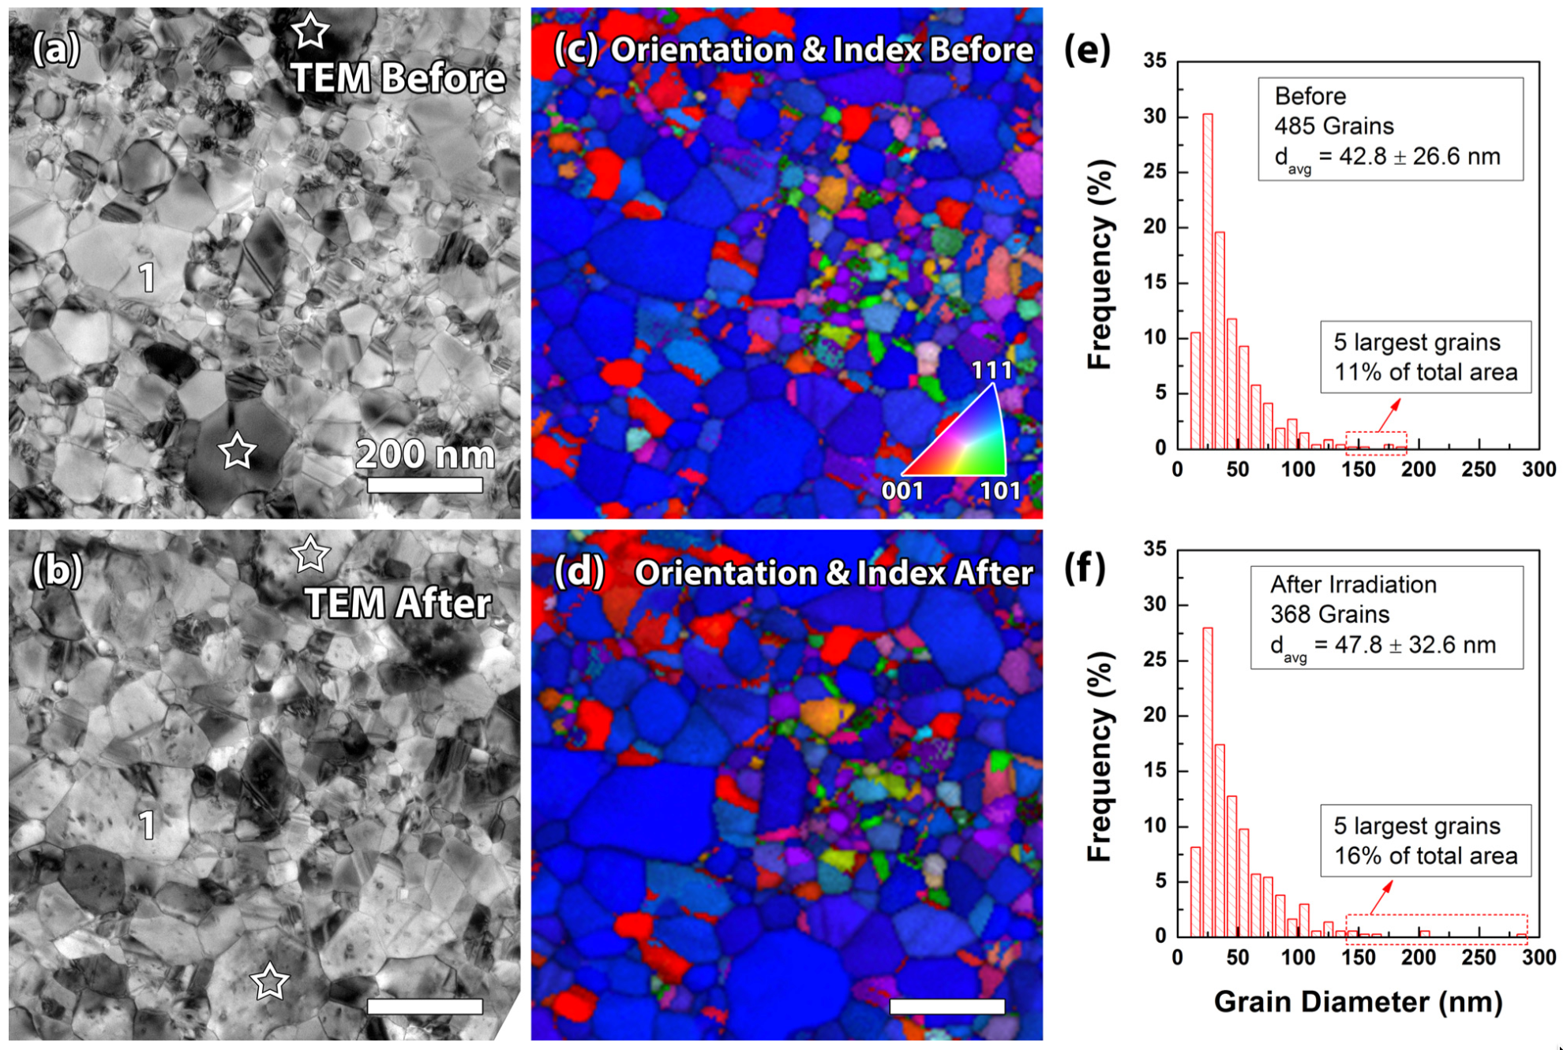
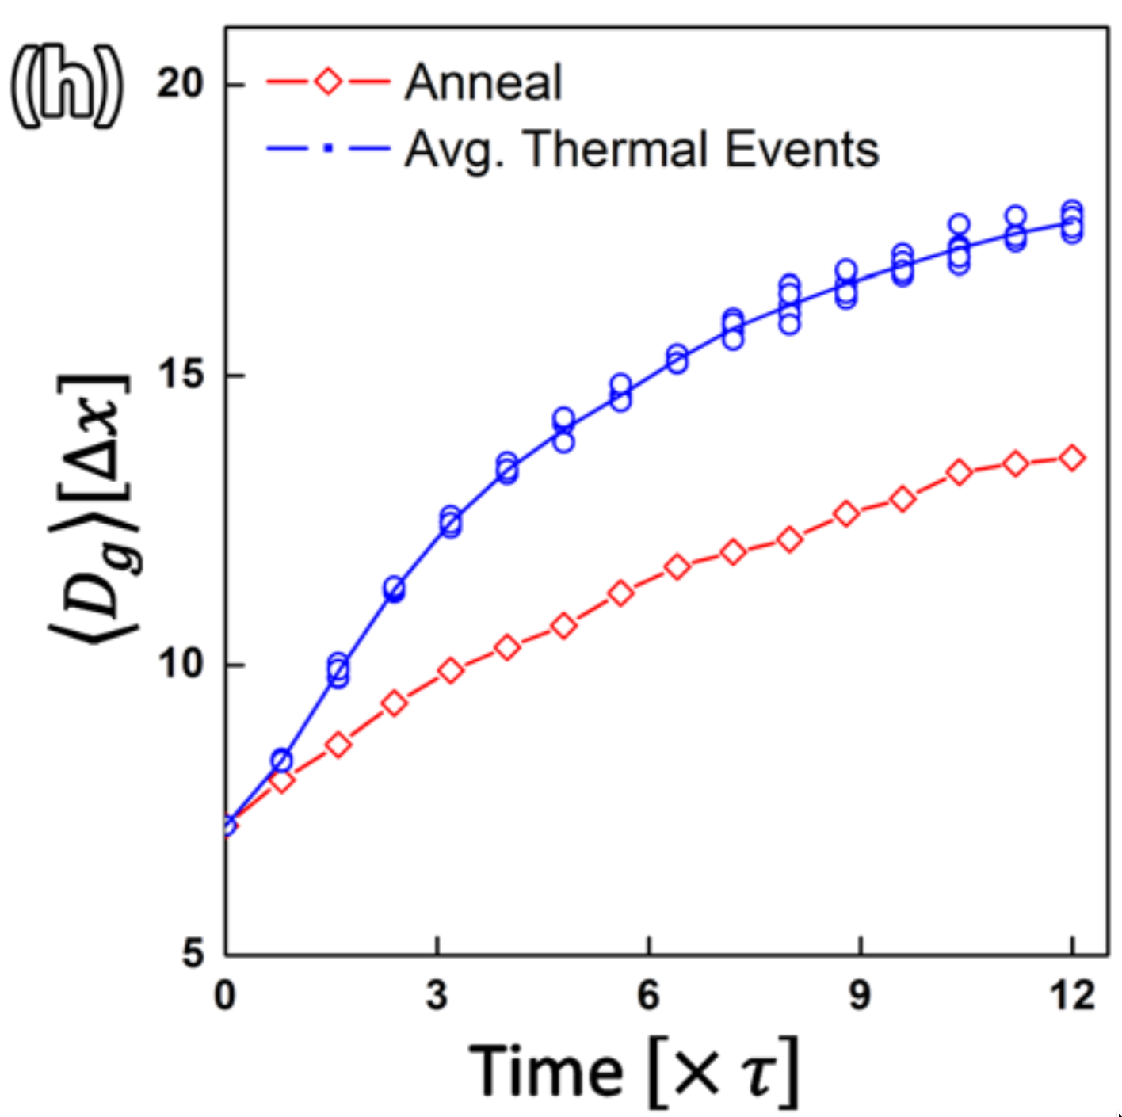
Irradiation can accelerate grain growth, but it is only significant with small grains and low temperature

Slide 24
Maximum grain size
Consider a material with an average grain size D
The change in D can be written as
k = 2 M_{GB} γ_{GB} is a rate constant that can be determined from experiments
D_{m} is the grain size at which the driving force equals the resistive pressure
For UO2:
D_{m} is a function of temperature microns

Slide 25
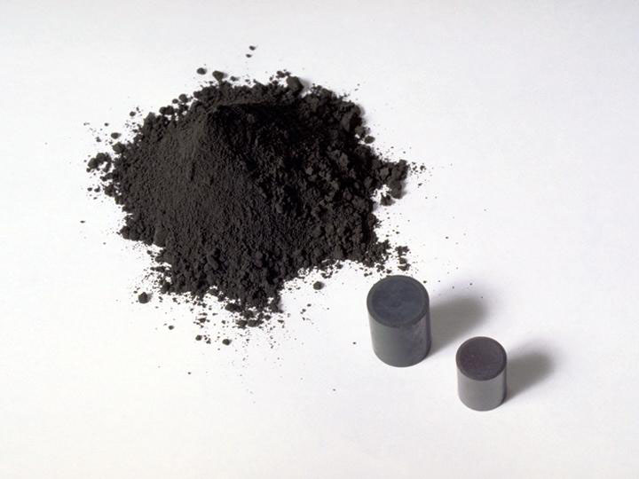
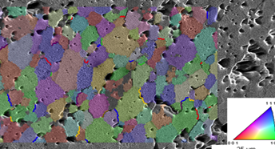
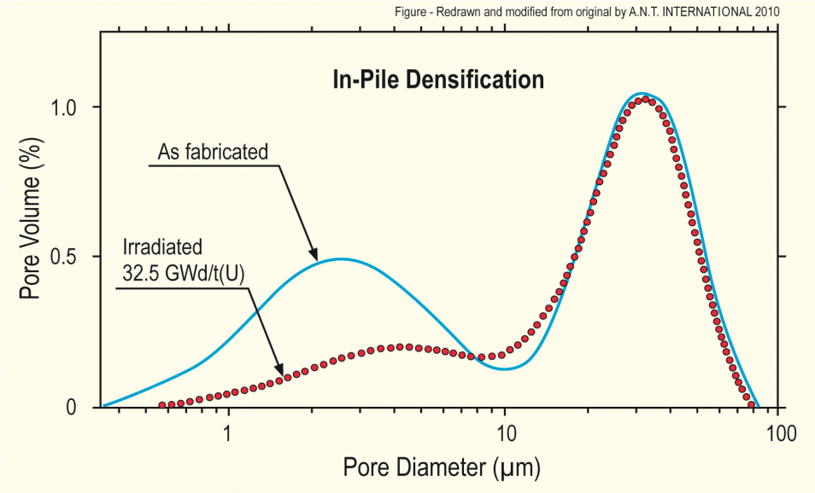
Fuel Densification
Remember that fresh fuel pellets are not fabricated to be 100% dense, more like 95-99% dense
Early in life, fuel pellets shrink and the initial porosity is largely eliminated
In some ways, densification is a continuation of the sintering process
However, irradiation accelerates the process
Small pores close due to effects of fission spikes and vacancy diffusion
Large pores stable (in absence of large hydrostatic stress)
Pellets with higher initial density, densify less

Slide 26
Densification
The driving force for densification is the change in free energy from the decrease in surface area of pores and lowering of the surface free energy
An empirical relation to describe densification has been built as a function of
β - Burnup (in FIMA)
Δρ₀ – Total densification that can occur ~ 0.01
β_{D} – Burnup at which densification stops ~5 MWD/kgU, ~0.005 FIMA
C_{D} = 7.235 − 0.0086 (T − 25) for T < 750C and CD = 1 for T ≥ 750C

Slide 27
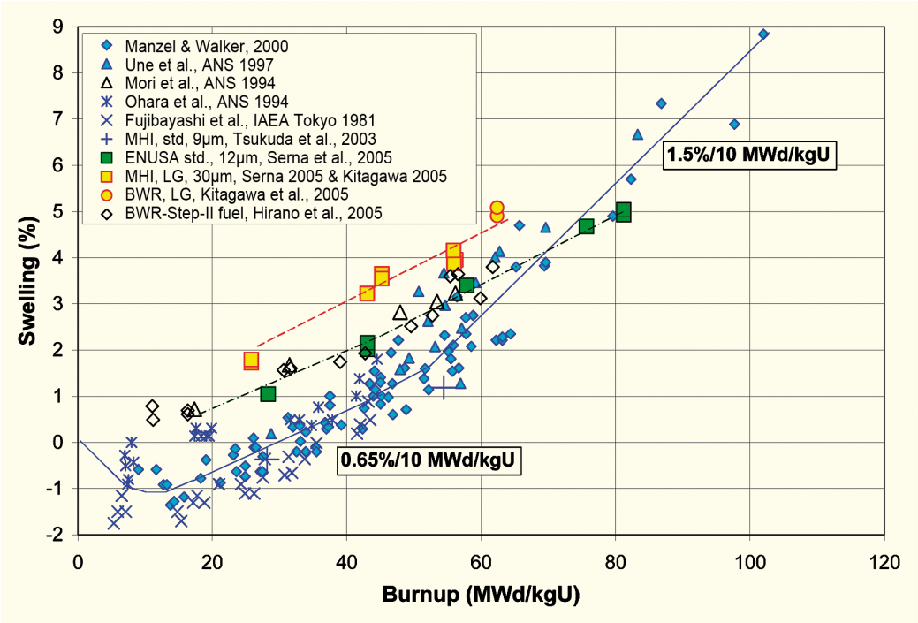
Empirical models
Many models of reactor fuel behavior are fits to experimental data
They are typically correlated to burnup
Burnup is a measure of how much fissioning has taken place. Typical units are:
MWD/kgU
FIMA
It can be calculated from the volumetric fission rate
Units of this equation are FIMA
To convert from FIMA to MWD/kgU, multiply by 950
after Garzarolli in [Rudling et al, 2007]

Slide 28
Summary
The average grain size in UO₂ impacts fuel behavior and performance:
Fission gas release
Swelling
Thermal conductivity
Creep
The material wants to reduce its energy by having large grains grow at the expense of small grains
Grain growth is reduced due to other defects reducing the grain boundary migration
Fuel densification is driven by reduction in surface area of pores – continuation of sintering process
Empirical models describe densification as a function of burnup

Slide 29
Notes
No class Tuesday
Presentations on Thursday
Problem Session 3/3
Exam 3/5

